Slide 1
EagleSat 2 – Program Directors Overview
Presented by: Hilliard Paige – Program Director
In cooperation with: Dr. Daniel White, Reece Krantz, Jason Hamburger, Becca Laub, Brennan Gray, David Stockhouse, Austin Macosky
27th Arizona Space Grant Symposium
Phoenix, Arizona
April 13th 2019

Slide 2
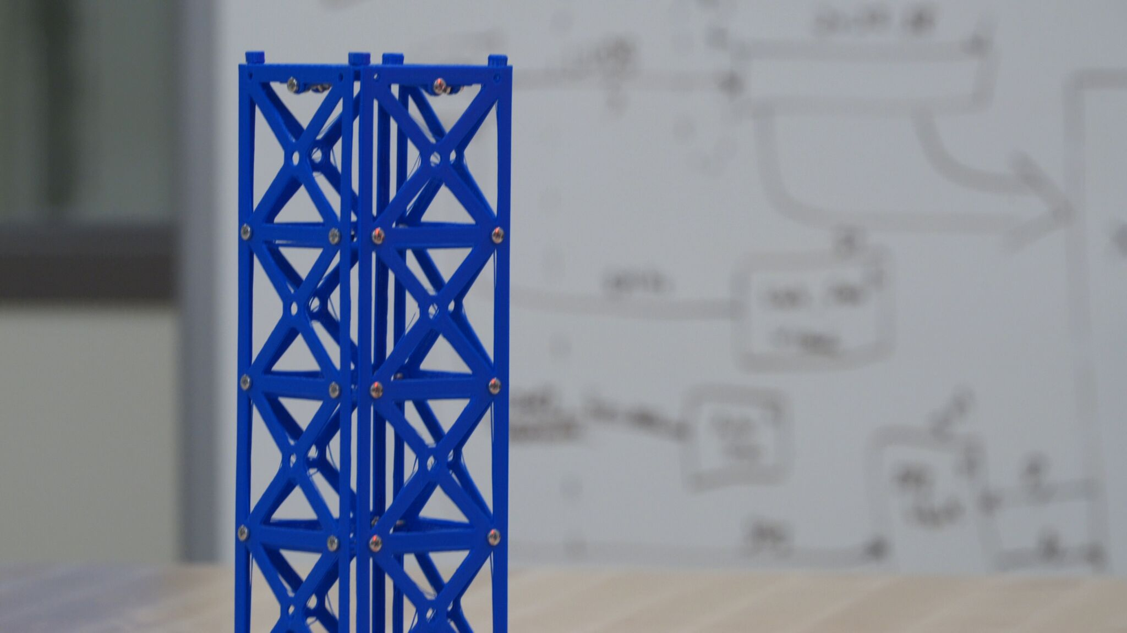
Outline
Mission Overview
Current Configuration
2018-2019 Developments
Major Milestones
Lessons Learned
Future Plans

Slide 3
Mission Overview
Scientific Goals
Spacecraft – 3U CubeSat
Scientific Goals
  Study of cosmic rays
  Study of how memory degrades in space
SELECTED - 2018 NASA CubeSat Launch Initiative
ISS orbit
  402-424 km
  51.6 degree inclination

Slide 4
Mission Success Criteria
Scientific
  Collect a minimum of 10 Cosmic Particles events including: orientation, energy level, energy loss.
  Demonstrate an ability to correlate radiation on-orbit to SEU bit flips
Technical
  Demonstrate an ability to autonomously operate and collect scientific data
  Possess full functionality to fulfill scientific goals
Operational
  6 month mission lifetime

Slide 5
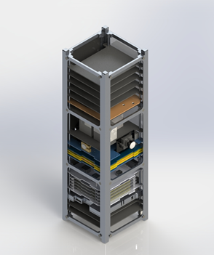
Configuration
Notes:
Power margins will be discussed in more detail with laurens presentation

Slide 6
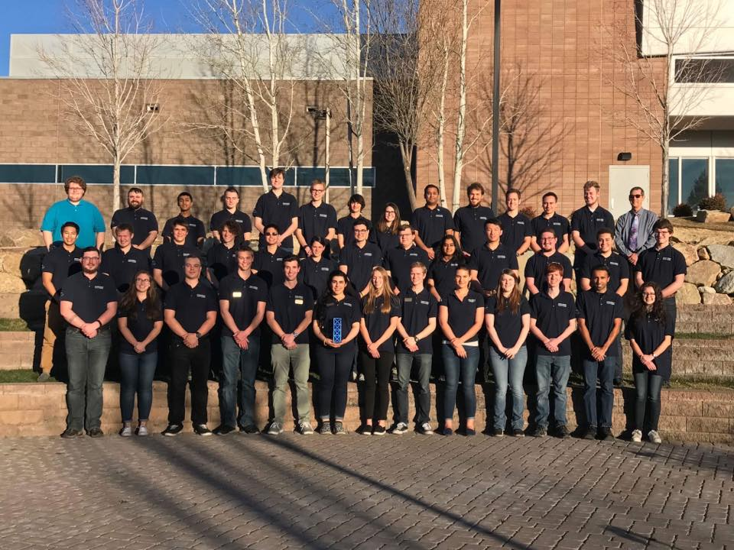
Purpose and Benefits
Education
Strong, achievable scientific goals
Commercially available bus systems
Work with teams, departments, and organizations both on and off campus

Slide 7
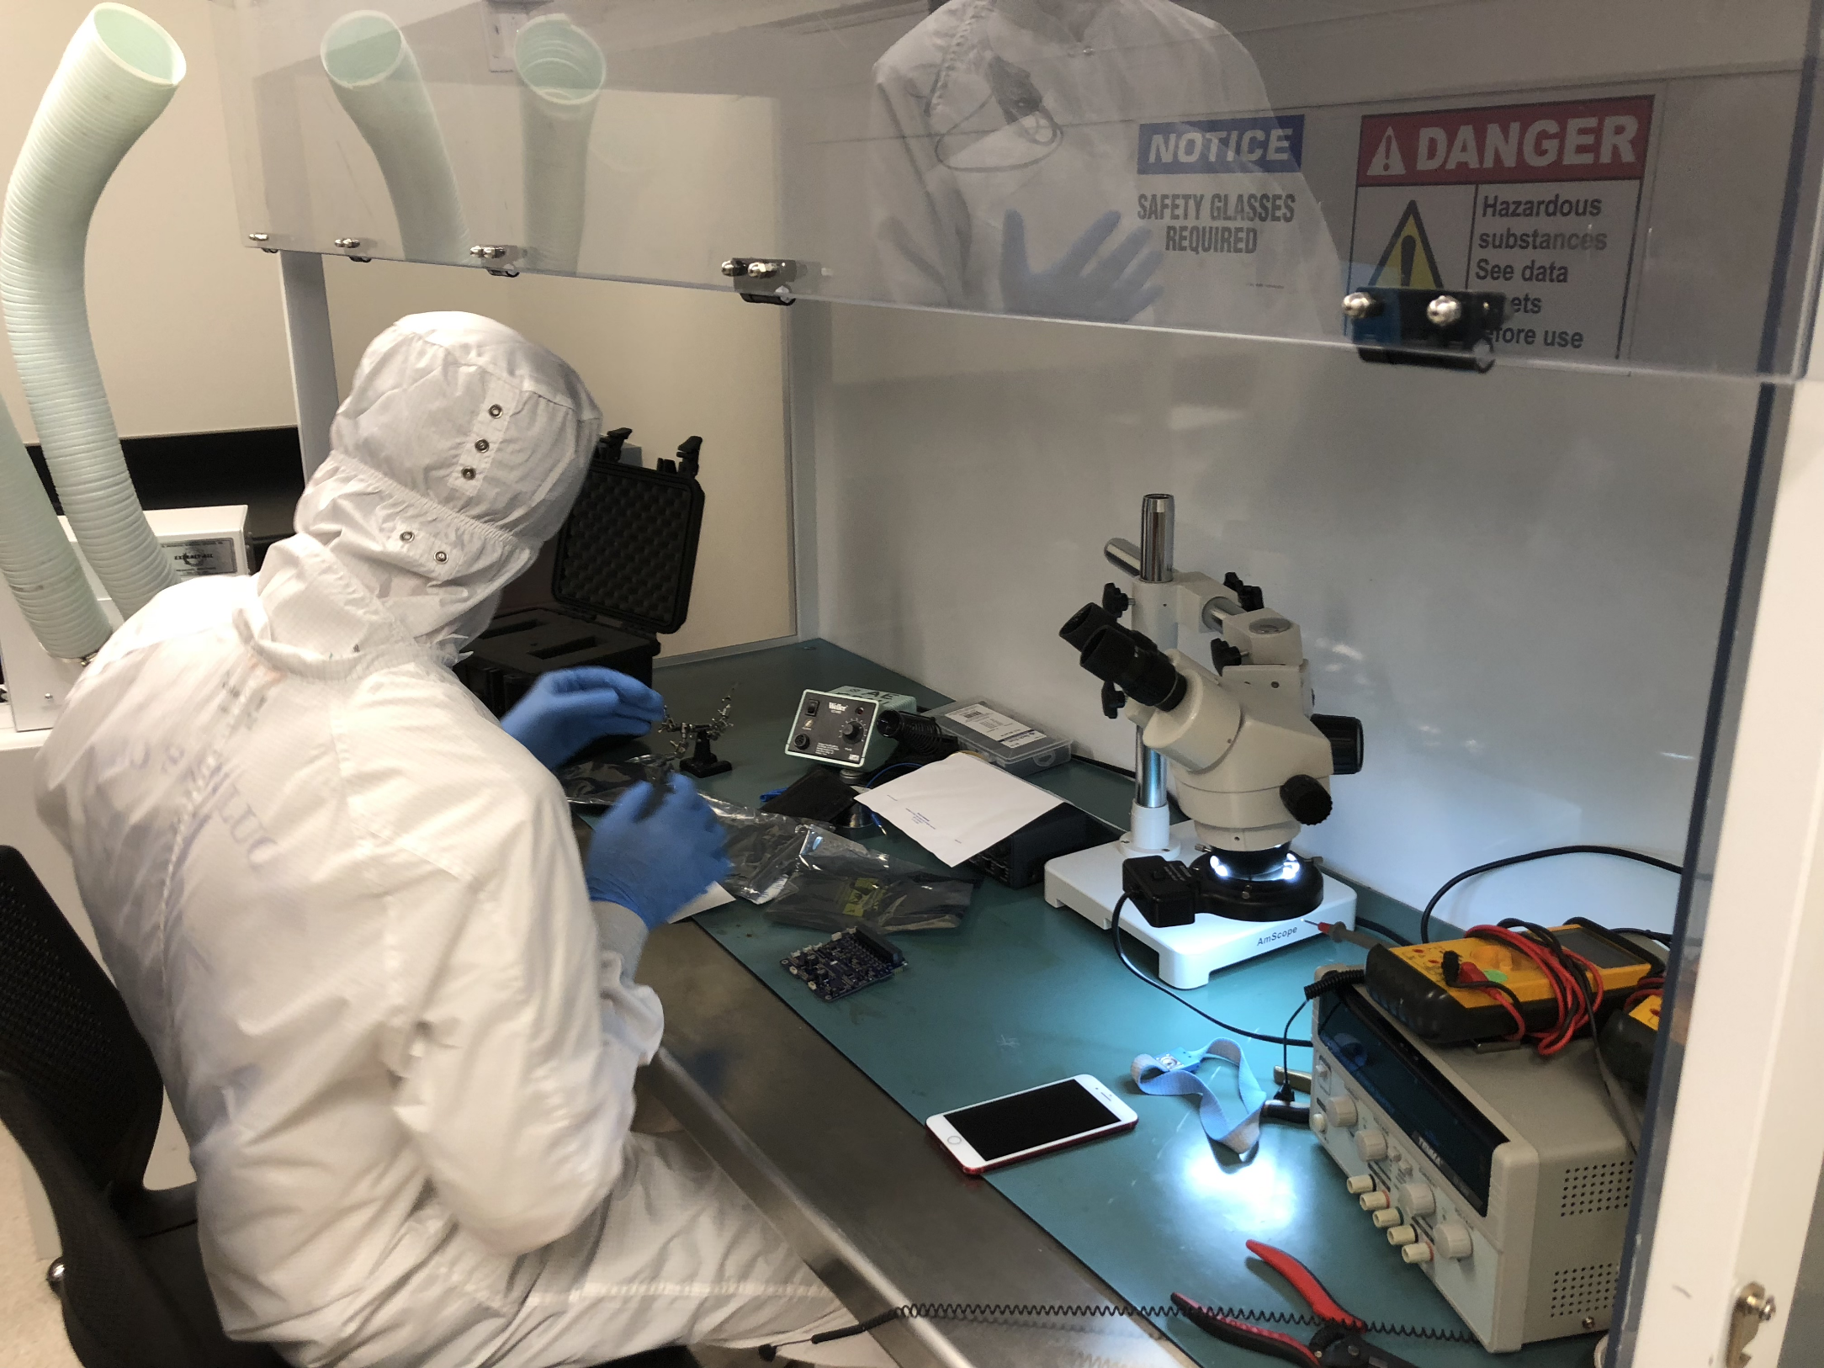

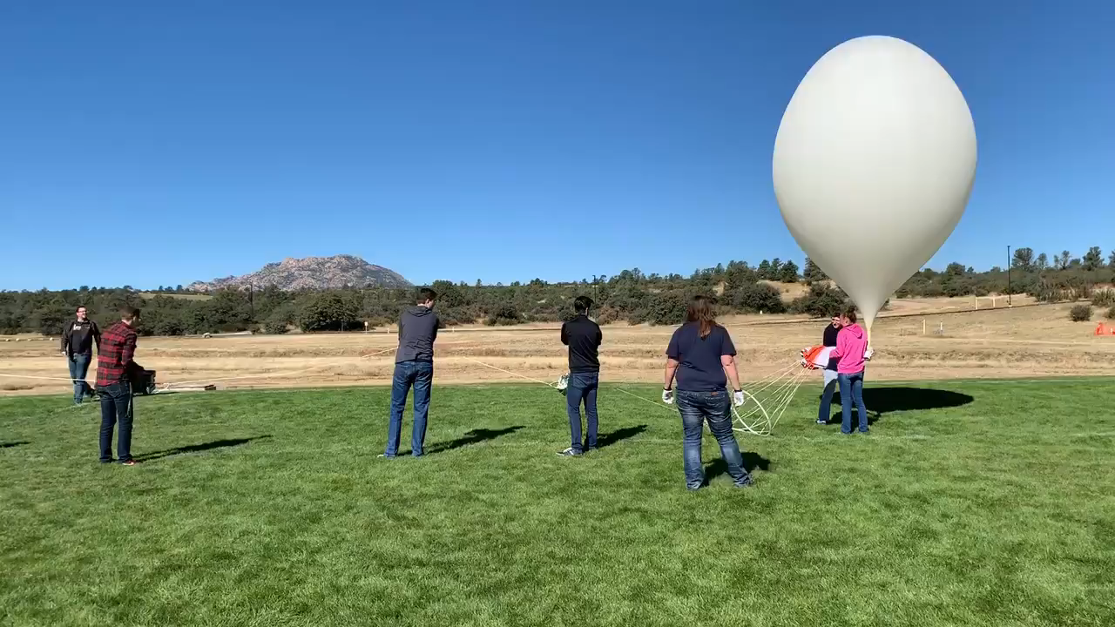
Development Progress (last12 months)

Slide 8
Lessons Learned (War Stories)
In Undergraduate Research, strong management and leadership is just as important as the researchers
Assemble a tight-knit community of people you trust
Make sure everyone knows what’s happening in all aspects of the program
Be wary of student burn-out
Take your estimated completion schedule and multiply it by pi
Always have contingency plans in case of emergencies

Slide 9
Acknowledgements
Dr. Daniel White, ERAU
Dr. Elliot Bryner, ERAU
Dr. Ronald Madler, ERAU
Travis Imken, JPL
Jim Weber, ERAU
Jeff Hyatt, ERAU
Arizona Space Grant
NASA CSLI

Slide 10
Conclusion
Development on EagleSat 2 is progressing as planned with estimated completion in 2020
Support from Arizona Space Grant helps greatly in achieving our goals
Next Milestone: CDR, Fall 2018
Questions / Comments: paigeh@my.erau.edu

